Slide 1
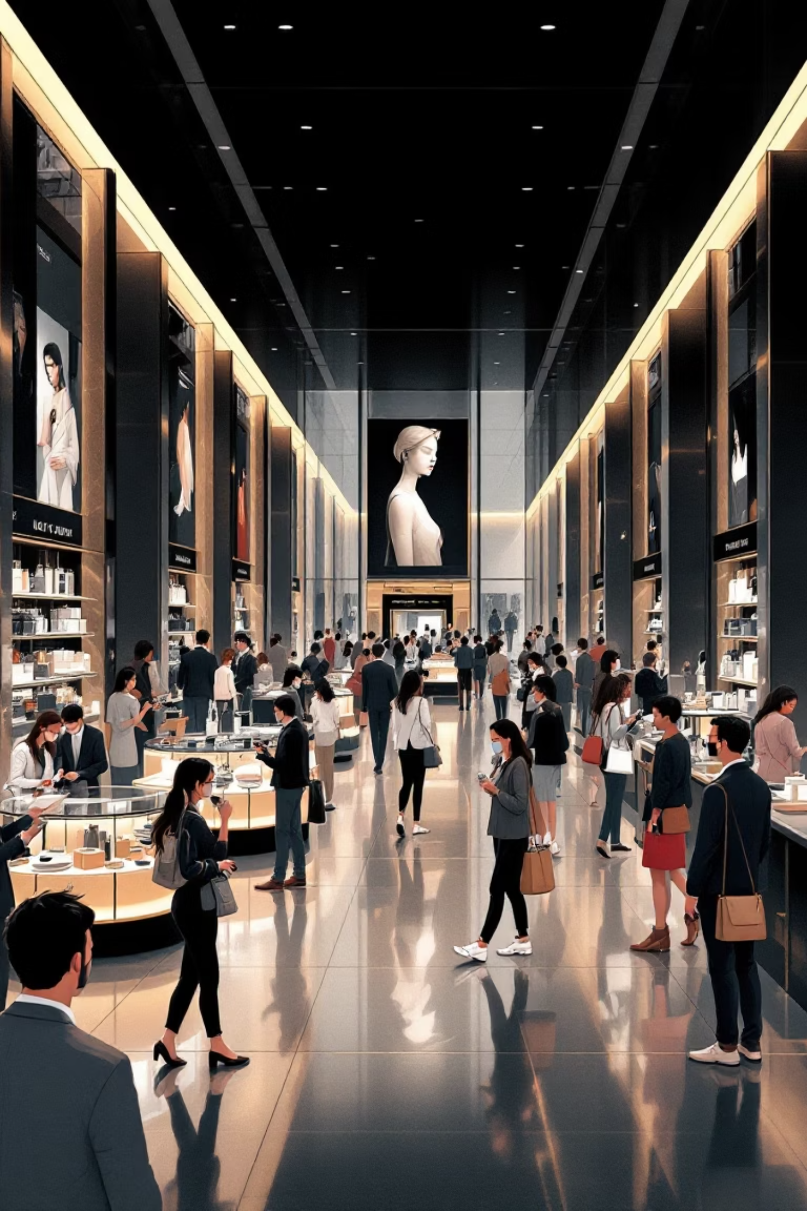
Customer Shopping Behavior Analysis
This project analyzes customer shopping behavior using transactional data to uncover insights into spending patterns, customer segments, product preferences, and subscription behavior. These insights will guide strategic business decisions.

Slide 2


Project Overview & Dataset Summary
Project Goal
Dataset Details
Uncover insights into spending patterns, customer segments, product preferences, and subscription behavior to guide strategic business decisions.
Rows: 3,900 purchases
Columns: 18 features (demographics, purchase details, shopping behavior)
Missing Data: 37 values in Review Rating column

Slide 3
Exploratory Data Analysis (EDA) in Python
We initiated our analysis with comprehensive data preparation and cleaning using Python.
Data Loading & Initial Exploration
Missing Data Handling
Column Standardization
Imputed missing Review Rating values using the median rating per product category.
Renamed columns to snake_case for improved readability and documentation.
Imported dataset with pandas and used df.info() and .describe() for structural and summary insights.
Feature Engineering
Data Consistency & Integration
Created age_group by binning ages and purchase_frequency_days from purchase data.
Dropped redundant promo_code_used and loaded the cleaned DataFrame into PostgreSQL for SQL analysis.

Slide 4





Key SQL Analysis Insights
Revenue by Gender
Male customers generated significantly more revenue ($157,890) than female customers ($75,191).
High-Spending Discount Users
Identified 839 customers who used discounts but still spent above the average purchase amount.
Top 5 Products by Rating
Gloves (3.86), Sandals (3.84), Boots (3.82), Hat (3.80), and Skirt (3.78) had the highest average ratings.
Shipping Type Comparison
Express shipping users had a slightly higher average purchase amount ($60.48) than Standard ($58.46).

Slide 5

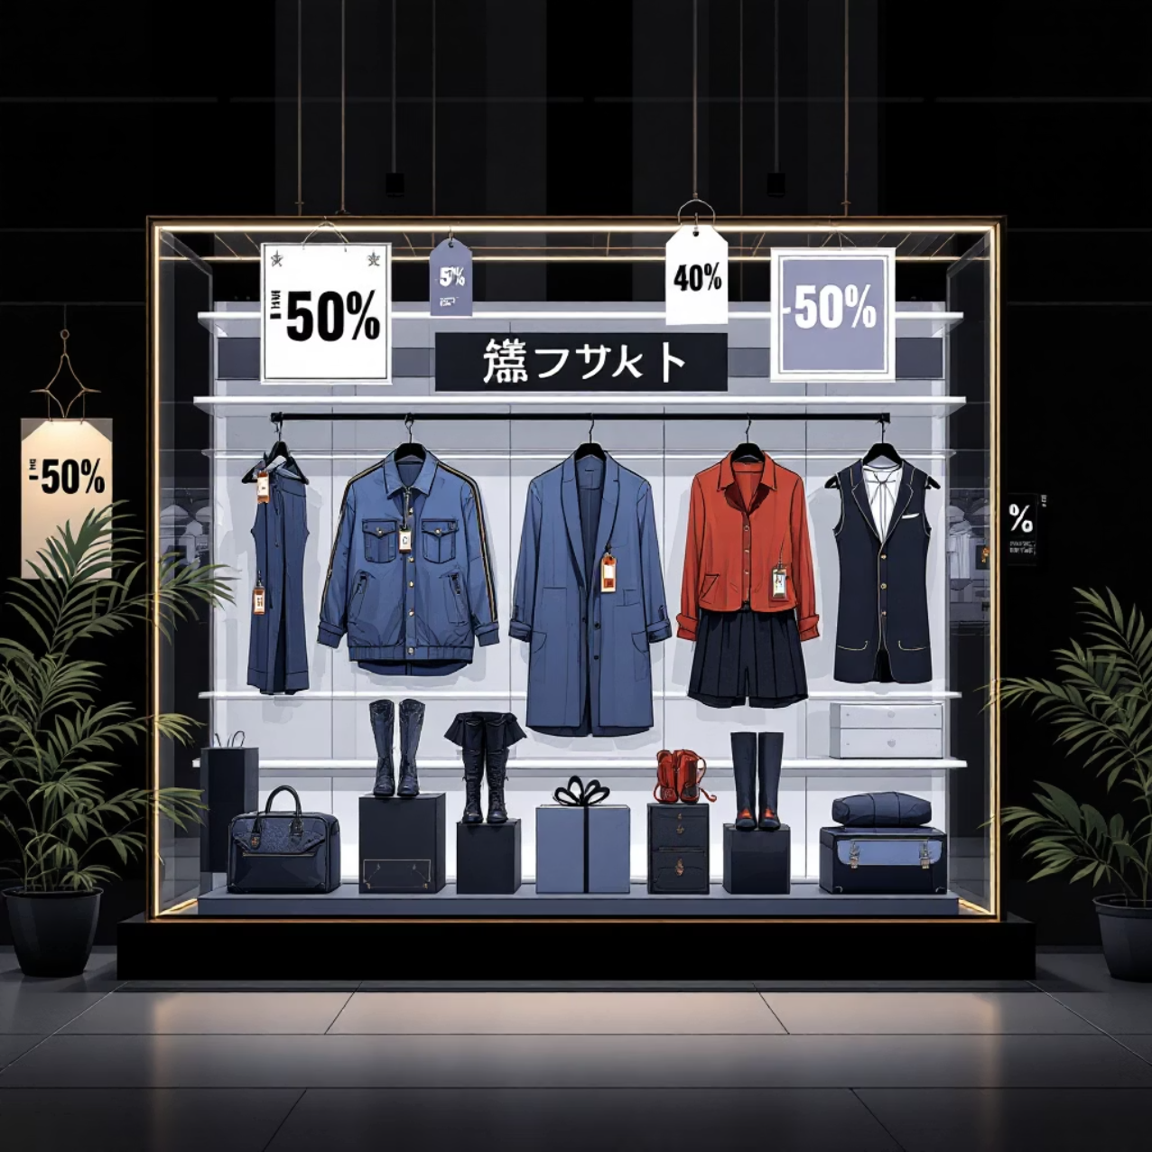
Subscription & Discount Analysis
Subscribers vs. Non-Subscribers
Discount-Dependent Products
Non-subscribers (2847 customers) generated higher total revenue ($170,436) compared to subscribers (1053 customers, $62,645), with similar average spend.
Products with the highest percentage of discounted purchases include Hat (50%), Sneakers (49.66%), Coat (49.07%), Sweater (48.17%), and Pants (47.37%).

Slide 6

Customer Segmentation & Product Performance
1
2
3
Customer Segmentation
Top Products per Category
Repeat Buyers & Subscriptions
Customers classified into Loyal (3116), Returning (701), and New (83) segments based on purchase history.
Identified top 3 products in Accessories (Jewelry, Sunglasses, Belt), Clothing (Blouse, Pants, Shirt), Footwear (Sandals, Shoes, Sneakers), and Outerwear (Jacket, Coat).
Repeat buyers (>5 purchases) are more likely to be non-subscribers (2518) than subscribers (958).

Slide 7
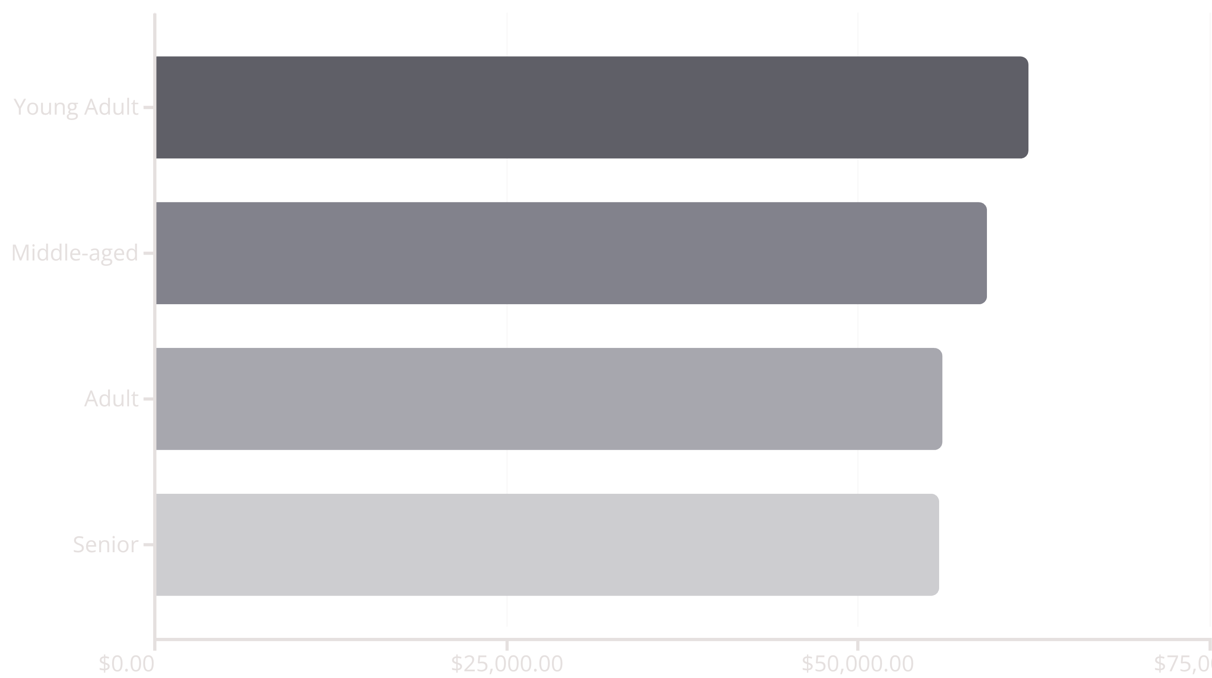
Revenue by Age Group
Young Adults contribute the highest total revenue, followed closely by Middle-aged customers, indicating strong purchasing power across these demographics.

Slide 8
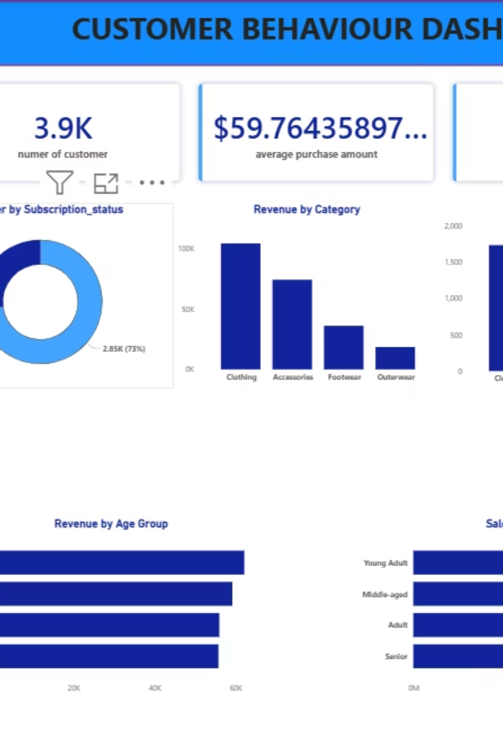
Power BI Dashboard: Customer Behavior
An interactive Power BI dashboard visualizes key metrics and insights, offering dynamic filtering by Subscription Status, Gender, Category, and Shipping Type.

Slide 9

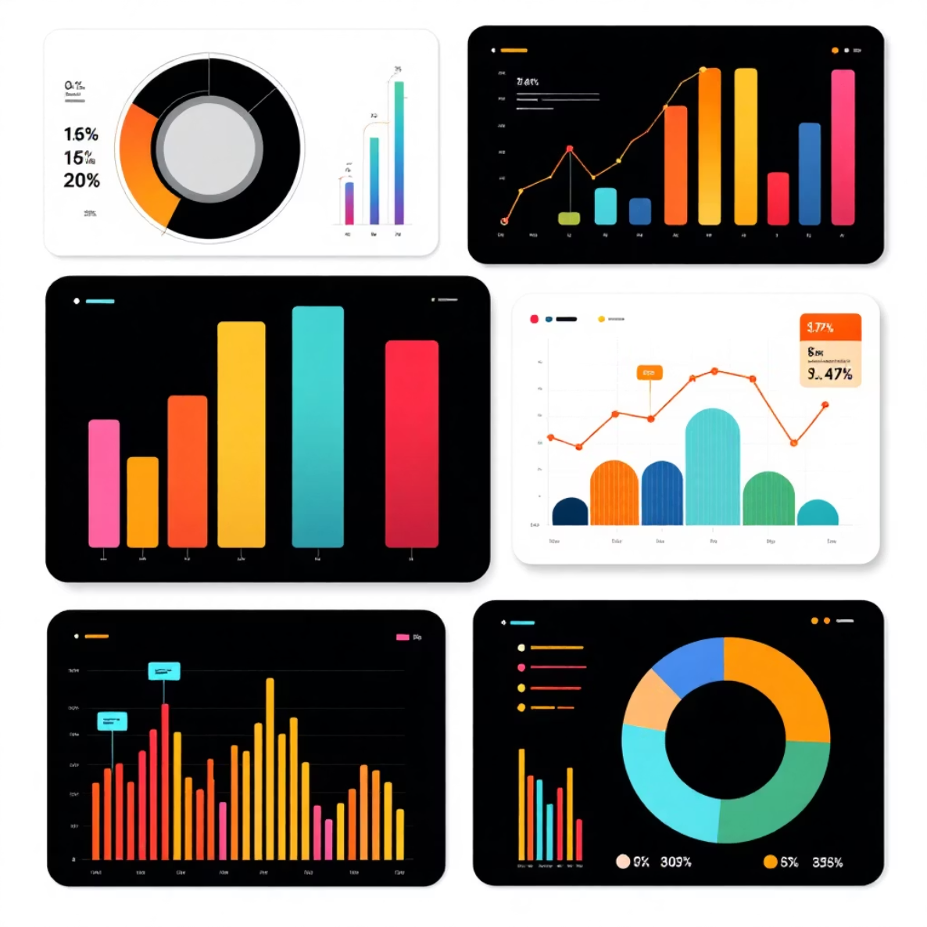
Dashboard Key Metrics & Visualizations
Key Metrics
Visualizations
Customers: 3.9K
% by Subscription: 27% Yes, 73% No
Avg. Purchase: $59.76
Revenue by Category: Clothing (100K), Accessories (80K), Footwear (40K), Outerwear (20K)
Avg. Review: 3.75
Sales by Age Group: Young Adult (1000), Middle-aged (900), Senior (800), Adult (700)

Slide 10





Strategic Business Recommendations
Boost Subscriptions
Promote exclusive benefits to increase subscriber base.
Customer Loyalty Programs
Reward repeat buyers to foster loyalty and move them into the “Loyal” segment.
Review Discount Policy
Balance sales boosts with margin control, especially for discount-dependent products.
Product Positioning
Highlight top-rated and best-selling products in marketing campaigns.
Targeted Marketing
Focus efforts on high-revenue age groups and express-shipping users for maximum impact.

